Slide 1

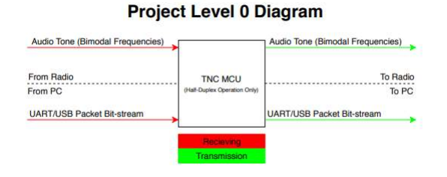
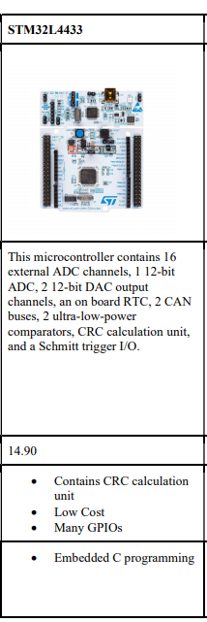
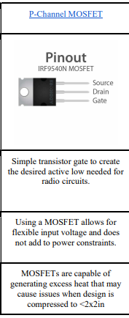
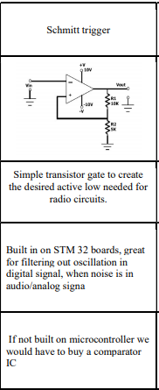
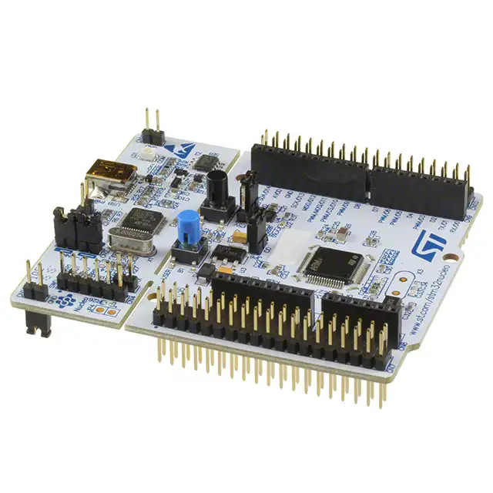
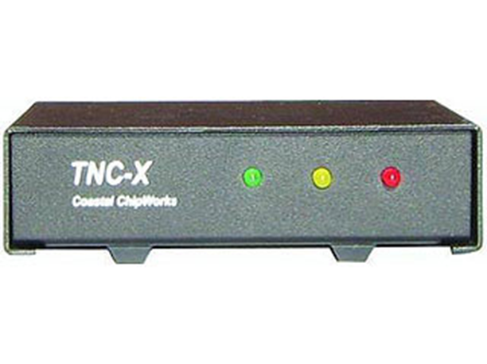
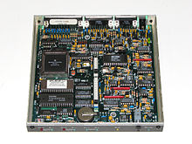
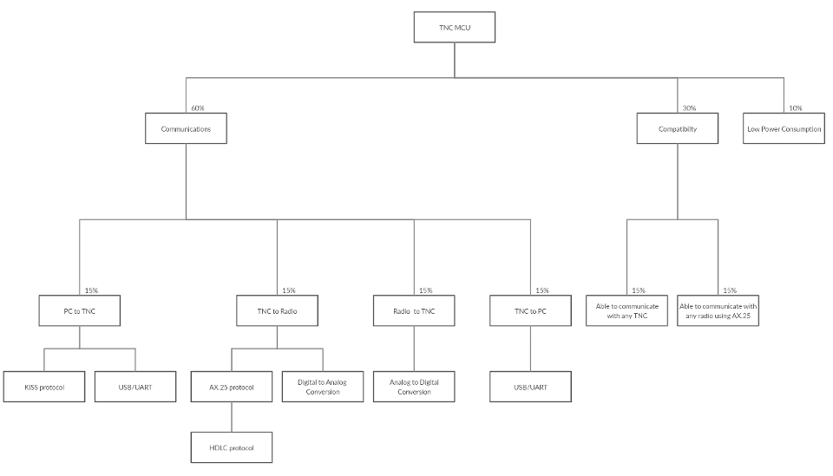
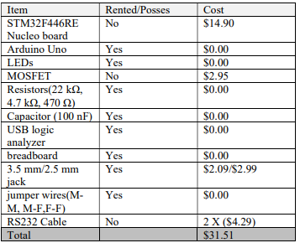
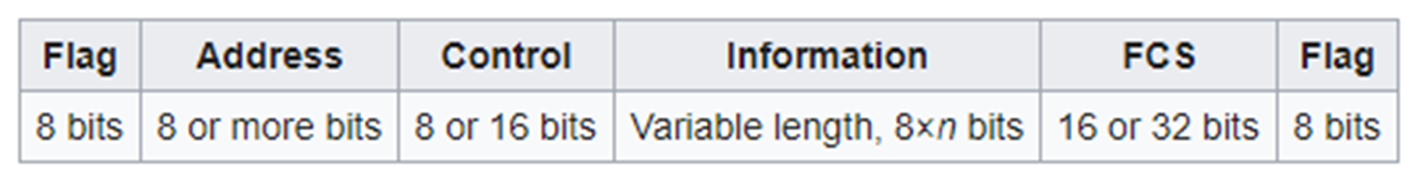


MCU Terminal Node Controller Design
Kaleb Leon, David Cain, Kobe Keopraseuth
Electrical and Computer Engineering Department
Abstract
System Objectives
Current Plan
The project discussed in this poster is what can be described as a Software TNC (Terminal Node Controller). The TNC will be able to perform all the basic functions of a hardware TNC but with little to no hardware necessary. It will be capable of receiving an audio tone FM modulated signal, convert it into binary, gather the payload, check for bit errors and send the payload to the PC via KISS (keep it simple, stupid) mode. I will also be able to receive a packet via KISS from the PC, follow the AX.25 protocol to form it into a valid data packet for radio communication, translate it into an FM modulated audio signal tone and send the tone to the radio.
Receiving
Receive Audio Tone Signal
Analog to digital convert into binary
Gather payload
Check for Errors
Send payload via KISS to PC
Transmitting
Receive KISS formatted data from PC
Follow AX.25 protocol to form data packet
Translate into analog audio tone signal
Send Audio tone to radio
C Code
We will be taking all the hardware TNC’s functions and programming them in C on the STM32 Nucleo board. This board has the capability to handle all of our ADC and DAC needs. The only external component in the plan as of now is the PTT (push to talk function) which turns the transmitter of the radio on and off based on a supplied voltage. In C, we will code the packet management following the designated transmission protocols and also convert that bit stream into a FM signal by APSK.
TNC ( Terminal Node Controller )
Hardware: Radio, TNC/Modem, Computer
Encoding
Computer to TNC – UART connection sending KISS packets (payload ASCII)
TNC to Radio – typically two or three wires, Audio Frequency Shift Keying (1200 baud) 0 = change in tone, 1 = no change in tone
Data Link (HDLC): AX.25
Radio
Feasibility
TNC
Computer or
Dumb Terminal
Technological Feasibility
Time Feasibility
The main goal of the project is aimed at replacing the hardware that was originally developed in the early 1980s, this means the technical requirements are very minimal. In addition, a previous design has been successfully achieved by a project called Direwolf meaning the design is feasible on a technological standpoint. Also, the hardware and protocols we plan on using is well documented and already implemented in hardware so it is very feasible to make the shift to software related logic.
Given the simplicity of packet management required to have a functioning TNC it seems it will be feasible to have close to a working design in the first half year. In addition, the second half year could be used to develop our own more optimized microcontroller board as well as add some features. According to the Gnatt Chat our planned schedule projects the projects feasibility in the time
span of one year.

